Slide 1




CONO-AI
YOUR AI VOICE ASSITANT

Slide 2
CONO : Vox Adiutor
Proposed solution:
Integrated AI Voice Assistant for Dynamic Conversational Engagement and Task Automation.
Features:
Designed a Voice Assistant that seamlessly authenticates users through face detection, ensuring secure and personalized access.
Delivers an uplifting daily quote to inspire and energize users.
Capable of solving general queries, sending WhatsApp messages, and offering a dedicated mode for entertainment.
Allows users to upload their favorite movies and access a personalized marketplace.
Features an easy-to-access navigation bar, designed for all age groups.

Slide 3
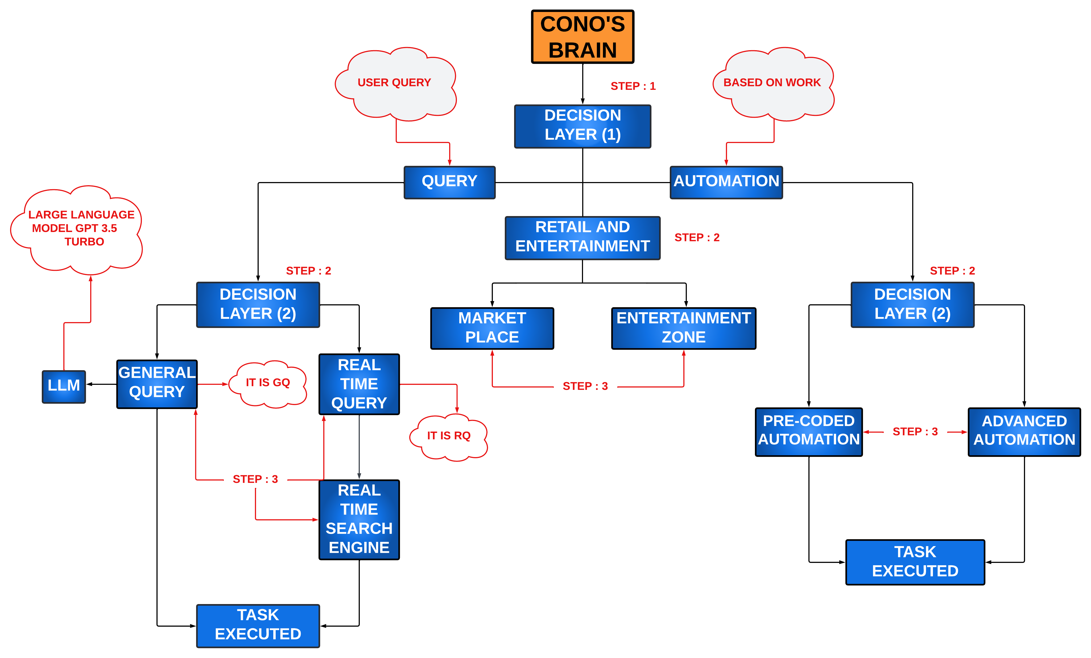
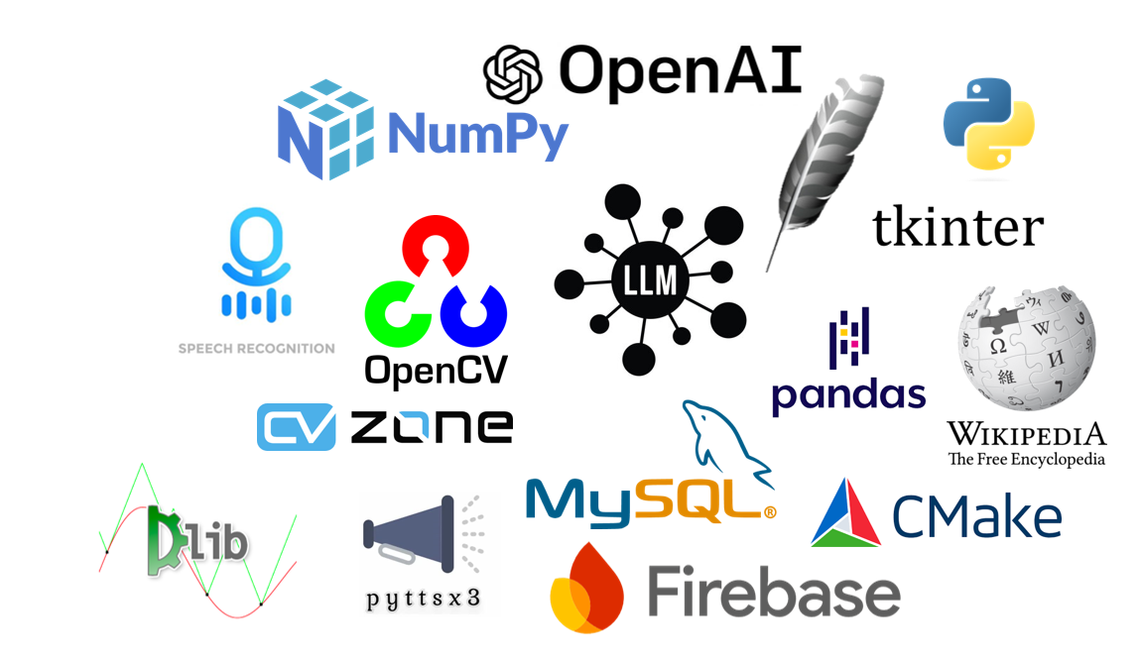
Programming language
Technologies used

Slide 4
FEASIBILITY AND VIABILITY
Feasibility Analysis:
Data Security:
Risk of unauthorized access, data breaches
Risk of loss of sensitive information
Solution: Implement encryption and secure authentication
User Adoption:
Risk of complexity
Risk of unfamiliarity
Solution: Provide user training, clear documentation, intuitive design
Technical Issues:
Risk of software bugs
Risk of system crashes
Solution: Regular maintenance, updates, thorough testing
Strategies for Overcoming Challenges:
Implement Advanced Security Protocols:
Utilize face detection for authentication.
Enforce strict access controls to protect sensitive information.
Enhance User Experience through Training and Support:
Provide detailed user manuals.
Offer step-by-step guides.
Ensure accessible customer support.
Ensure Application Stability with Regular Maintenance:
Schedule frequent software updates.
Perform regular bug fixes.
Conduct performance checks to maintain reliability.

Slide 5
IMPACT AND BENEFITS
Personalization: Customizes experiences to individual preferences, boosting satisfaction.
Convenience: Automates daily tasks, saving time and effort.
Enhanced Security: Uses technologies like face recognition to secure user data.
Trust Building: Strengthens user confidence, especially in sensitive sectors.
Scalability: Offers benefits across various sectors, adaptable to industry needs.
Innovation: Positions the project as a leader with advanced solutions.
Automation: Handles routine tasks, reducing business workload.
Cost Savings: Lowers labor costs, allowing focus on strategic activities.
Enhanced Engagement: Increases user retention through interactive experiences.
Competitive Edge: Distinguishes businesses with advanced, secure, and personalized services.

Slide 6
RESEARCH AND REFERENCES
[1] L. Liu, J. Meng, and Y. Yang, “LLM Technologies and Information Search,” Journal of Economy and Technology, vol. 2, pp. 269–277, Nov. 2024. doi:10.1016/j.ject.2024.08.007
[2] Islam, R., & Moushi, O. M. (2024). GPT-4O: The Cutting-Edge Advancement in Multimodal LLM. https://doi.org/10.36227/techrxiv.171986596.65533294/v1
[3] Kanashev, M., Mukasheva, A., Yedilkhan, D., Rakhmetulaeva, S., Gnatyuk, S., & Nazym, M. (2024). Research and development of an information system for speech recognition based on neural network algorithms metrics. 2024 IEEE 4th International Conference on Smart Information Systems and Technologies (SIST), 13, 314–320. https://doi.org/10.1109/sist61555.2024.10629440
[4] Kaswan, K. S., Dhatterwal, J. S., & Balamurugan, B. (2023). GUI programming using Tkinter. Python for Beginners, 313–347. https://doi.org/10.1201/9781003202035-12
[5] P K B, P., & J, M. (2020). Design and evaluation of a real-time face recognition system using convolutional neural networks. Procedia Computer Science, 171, 1651–1659. https://doi.org/10.1016/j.procs.2020.04.177
[6] Singh, H. (2019). Advanced image processing using opencv. Practical Machine Learning and Image Processing, 63–88. https://doi.org/10.1007/978-1-4842-4149-3_4
[7] Xiao Han, Qingdong Du (2018) "Research on face recognition based on deep learning." Sixth International Conference on Digital Information, Networking, and Wireless Communications, 2018
[8] AD Moore (2018) "Python GUI Programming with Tkinter: Develop responsive and powerful GUI applications with Tkinter."

